Slide 1




תחבורת העתיד- ייצור מימן ברכב
Tareq Abu Hamed
Yulia Gusarov
Flavia Spires

Slide 2
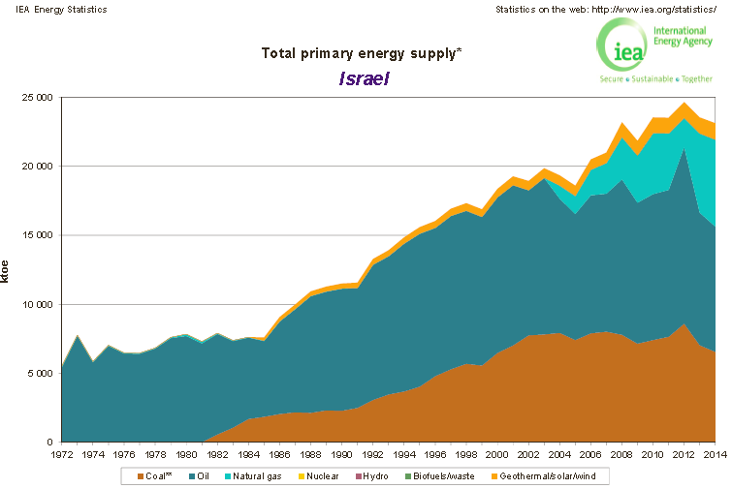

Slide 3
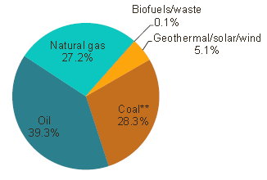
Share of total Primary Energy Supply - 2014
Israel-22 696 ktoe

Slide 4
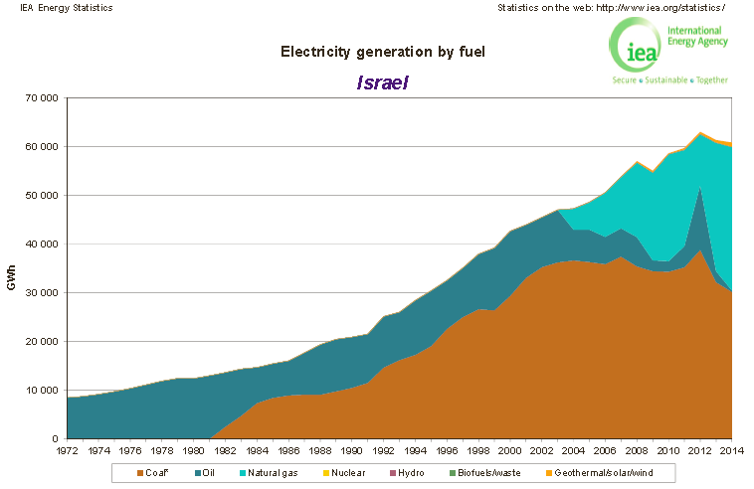
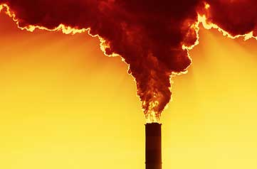

Slide 5
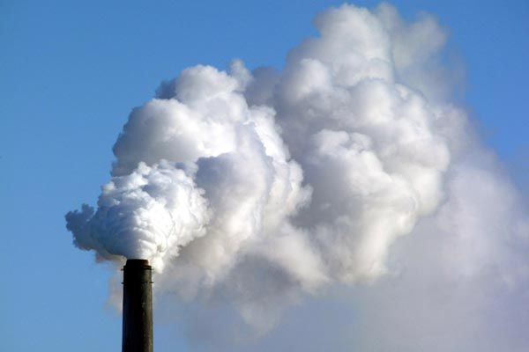

Slide 6
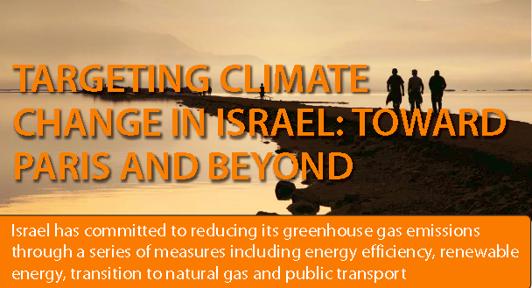
Israel’s National Circumstances
› High population growth rate (~1.8% annually)
› High GDP growth rate per capita above the OECD average
› Electricity generation largely based on fossil fuels
› Limited land area available for solar installations and wind farms
› No hydro-electric, geothermal or nuclear power
› Energy island without grid interconnectivity
› Growth rate of electricity demand about 2.5% per year

Slide 7
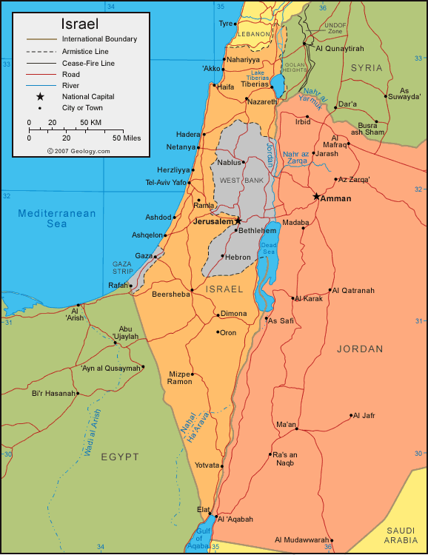
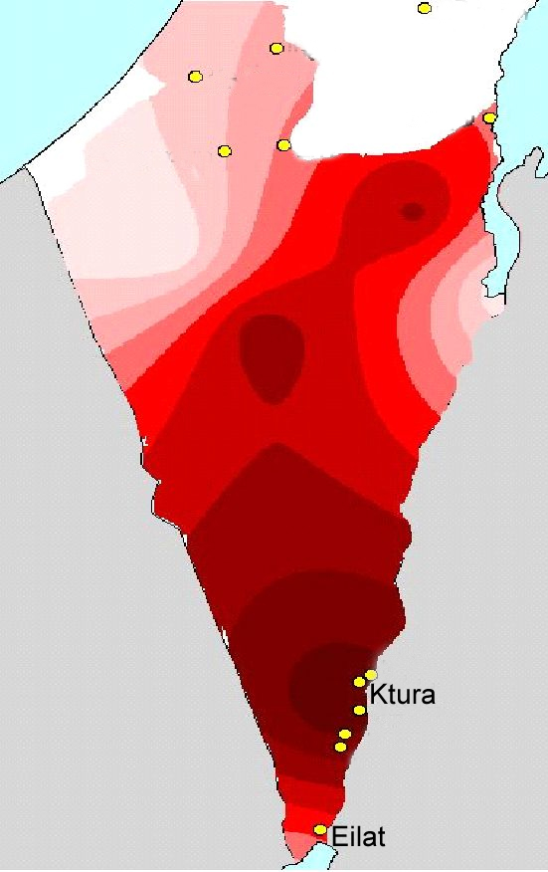
1m² collects 5 kWh every day, or the energy equivalent of a barrel of oil per year.
Solar radiation map
1100W/m²

Slide 8
Hydrogen Production via Metal Hydrolysis by Thermochemical Cycles
Tareq Abu Hamed
Yulia Gusarov
Flavia Spires

Slide 9

Hydrogen as an Alternative
Clean source – no GHG emission
Hydrogen is abundant
Mature technology is available to use
Page 9

Slide 10


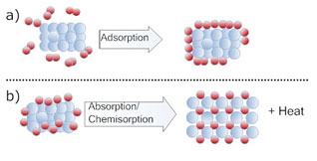

Hydrogen Production
Hydrogen Storage
Hydrogen Commercial Production Method
Carbothermal
96%
Natural Gas Reforming
48%
Petroleum Cracking
30%
Electrolysis
4%
Coal Gasification
18%
Storage Method |  | Energy Content
 |  | Gravimetric Density | Volumetric Density
Compressed hydrogen gas |  | 6 % | 32 kg/m3
Liquid Hydrogen |  | 23 % | 72 kg/ m3
Complex hydrides (Group I, II, and III elements, Li, Mg, B, Al, build a large variety of metal–hydrogen |  | 2- 18% | 80- 150 kg/m3
Metals anhydride (B, Al , Mg) |  | 2- 7.8% | 24-55.6 kg/m3
Page 10
Notes:
One of the remaining problems currently slowing down hydrogen’s ability to saturate the energy market is that with hydrogen it is hard to store and transport in economical scales.

Slide 11
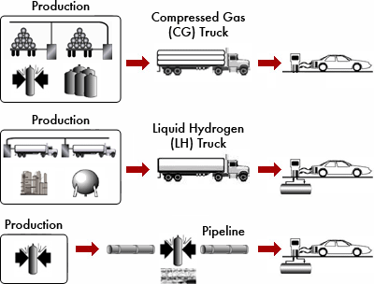
Problem related with H₂ Economy
Production
Storage
Distribution
Dispensing station
Infrastructure cost
DOE.2010
Page 11

Slide 12
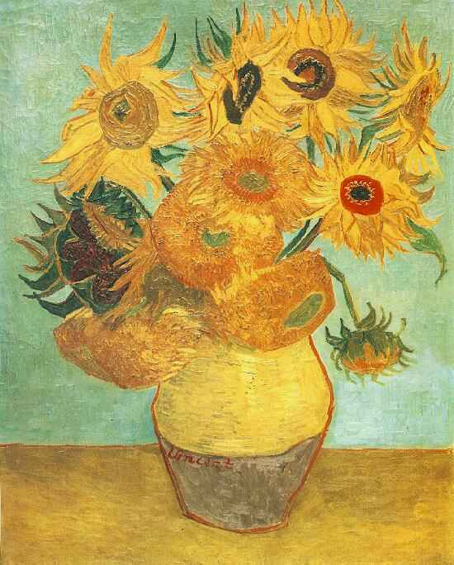
Example: Multiple-step process to split water
SOLAR REACTOR
3/2 O₂
Al₂O₃
Al₂O₃= 2Al + 3/2 O₂
2Al
May 1889
It worries me a lot when I think that I have done so many pictures and drawings without ever selling one.
Vincent van Gogh
HYDROLYSER
3H₂
3H₂O
2Al+3H₂O=Al₂O₃+3H₂
recycle
Al₂O₃

Slide 13
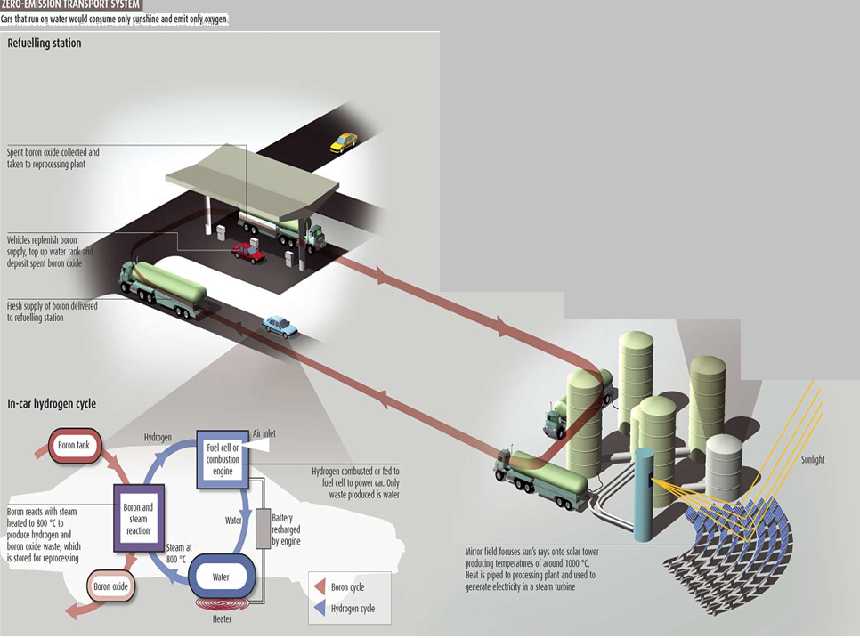
Zero Emission Transport System
Refueling Station
Car that run on water would consume only sunshine and emit Oxygen

Slide 14
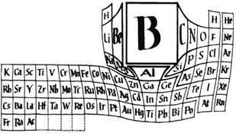
1- Low density compared to other element.
2- High energy content.
3- Stability Under STP.
4- 5- EPA.. Non-carcinogenic
Page 14
Notes:
Today, around 50 million tons of hydrogen are produced every year and used worldwide

Slide 15

Future Fuel parameters
Storage parameter | Unit | Target
 |  | 2010 | 2015 | Ultimate full fleet = light fuel vehicles
System gravimetric capacity | Kg H₂/kg | 6 | 5.5 | 7.5
System Volumetric capacity | Kg H₂/L | 45 | 40 | 70
Minimum/maximum delivery temperature | ºC | -40 to 85 | -40 to 85 | -40 to 85
Cycle life | Cycles | 1000 | 1500 | 1500
System fill time (for 5 kg) | min | 3 | 2.5 | 2.5
US Department of Energy

Slide 17
Hydrogen production Rate at different aluminum surface area
25 ºC & 1 M

Slide 19
“If A Leaf Can Do It, We Can Do It”
Professor James Barber
Imperial College London, UK

Slide 20
The future is brighter!
15 Sunflowers
1987 - $40 Million

